Slide 1

Visions for 2025
Reimagining Lessons
[not] Learned
Using the power of the community to reimagine how we deliver projects through the application of advanced project data analytics and AI
Get involved and unlock your superpowers

Slide 2

In summary
The lessons learned process is fundamentally broken. The same mistakes are being made and we struggle to leverage our collective experience. But what could that future look like? In simple terms:
We improve how we collect and curate our data, to enable us to leverage our experience downstream.
We move beyond spreadsheet driven approaches to lessons learned towards using machine learning to prompt us on what lies ahead, its potential impact and to provide advice on courses of action.
We create the equivalent of a satnav for projects. Advising on where potential delays are likely to emerge from, or how to accelerate.
The concept of humans learning everything about everything is illogical. We must change our approach.
Our collective hard won experience, codified in data, holds the key.

Slide 3
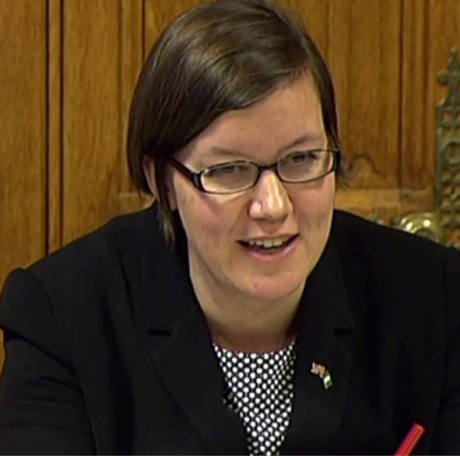
Why we must change
Dame Meg Hillier
Public Accounts Committee
Lessons learned remains a wicked problem for the project delivery profession, where organisational learning from projects rarely happens, and when it does it fails to deliver the intended results. The National Audit Office, Public Accounts Committee and numerous other organisations have reported at length on the fact that we struggle to learn from previous projects.
Projecting Success collated ~20,000 lessons learned and concluded that most organisations are unable to demonstrate that lessons are being learned. The lessons are generally superficial, anodyne and repeat established good practice.
In a data driven world we can no longer work on an abstraction of reality, laden with bias. We must leverage the source data, using the insights from this data to help to shape our interventions. There is no excuse.
“To utterly fail to learn from mistakes over decades, to spectacularly repeat the same mistakes at huge cost to the taxpayer – and at huge cost to confidence in our defence capabilities – is completely unacceptable.
We see too often these same mistakes repeated. The Department knows it can’t go on like this, it knows it must change and operate differently. The test now is to see how it will do that, and soon”

Slide 4
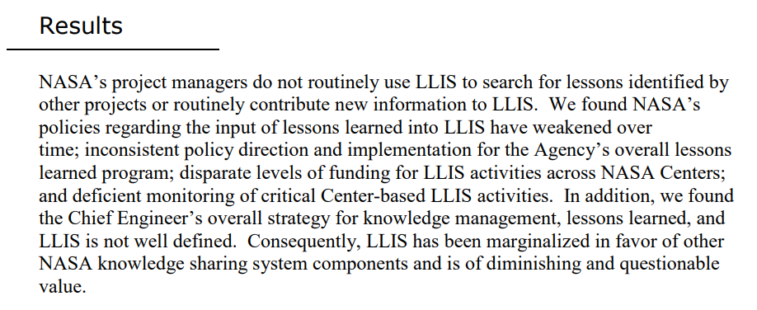

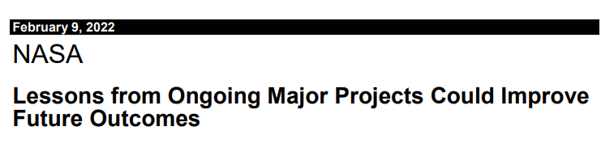
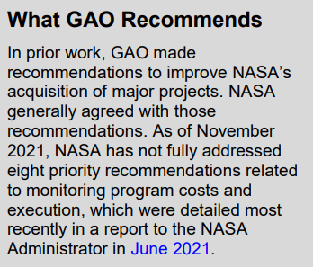
An example: NASA
In 2001 the Government Accountability Office reviewed NASA’s approach to lessons learned, and NASA reviewed again in 2012 concluding:
Limited sharing of lessons learned NASA wide.
The lessons are not a primary mechanism for collecting and sharing lessons learned.
Managers are not using the lessons learned systems.
Dissatisfaction with lessons learned processes and systems.
Inconsistent policy direction and implementation.
Lack of monitoring.
There are numerous barriers to learning lessons.
Even in 2022, the GAO is still writing reports on how lessons from ongoing major projects could improve future outcomes.

Slide 5

Curating the data
The first step is to collect, curate and integrate the data. Although we often manage the data in silos, it is actually interconnected and mutually dependent. When we approve a change, it has an impact on resourcing, cost, schedule and more.
Individually, an organisation will struggle to acquire enough data to train the algorithms to pre-empt variance. But when we pool the data in a data trust, we create an asset that works for everyone.
A data first approach, leveraging the years of knowledge accrued from developing data trusts.

Slide 6
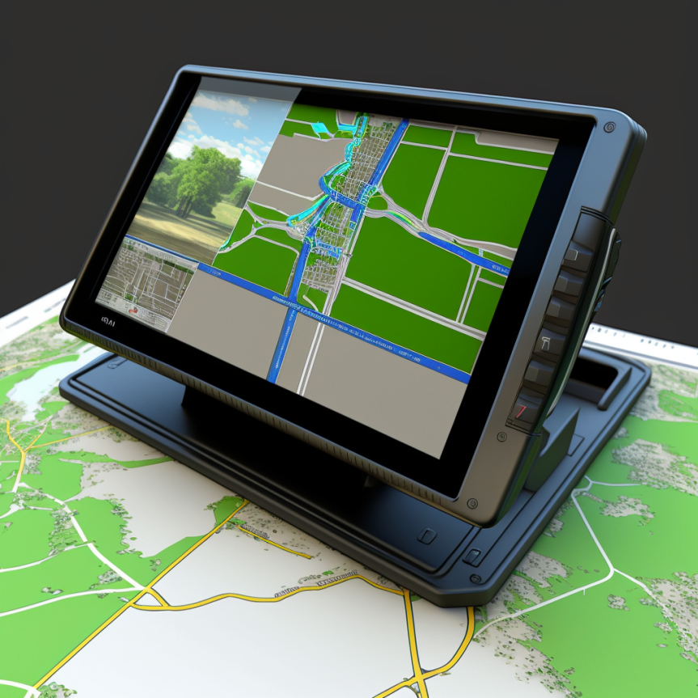
A Project Satnav
We understand which parts of the project journey are more susceptible to delay or cost increase, what influences this and what the likely impact could be. We are alert to potential dangers or opportunities.
We leverage our shared experience to understand what worked and what didn’t.
We use the encoded data and narrative to deduce how likely something is to arise on our project. We gain insights into causality. We can use this information to help us mitigate.
We close the loop between risks, issues, other variance events and lessons, ensuring we connect and leverage the data.

Slide 7

Beyond Lessons Learned
This is no longer about lessons learned. It is about leveraging our collective hard won experience.
We can leverage the actual vs planned from every project, so we can optimise. We understand which benefits weren’t delivered and why, which shapes our approach in the future.
We understand which mitigations worked and why.
We use machine learning to look for parallels at a function, work package and product level. What challenges did the nuclear regulator raise and how were they mitigated? How can we optimise for specific ground conditions? The transformation project took 30% longer than planned; why?
We can anchor against the specifics and then adapt
A very different proposition.

Slide 8

Variance driven
Rather than collating lessons learned at the end of the project, we have a steady stream of consciousness, capturing key data on the project as it develops. We curate the data plume that would otherwise be discarded.
When the project experiences a variance event, we curate the data and tag it so that if we go along a similar path in the future the analyst can make us aware of what we are about to run into.
We have the evidence to back up any investment plans. We challenge optimism bias.
We can fast forward or replay. A project delivery version of the ‘Minority Report’.

Slide 9

Evidence Based Assurance
We leverage our collective experience to provide an independent perspective on where variance is likely to emerge. Is the project team listening to the evidence or blindly steaming ahead?
Such an approach augments the assessor, rather than replacing them. It helps to provide the evidence to challenge group think and bias.
We no longer have discussions about who is right, with the most senior person in the room having the final say.
We create a data driven pool of insights to provide an independent perspective. This stimulates discussion and forensic inquiry.

Slide 10

Helping Senior Leaders to Sleep at Night
We leverage our collective experience to avoid the avoidable. This experience may sometime be out of reach of the team, but is available… if we have the capability to curate and access it.
We help to surface:
The evidence to validate our approach and shape our investments to tackle known knowns.
The known unknowns. We aware that there is potential for variance. By pooling this experience we make it accessible.
The unknown unknowns. The things that we haven’t thought of, but the analysis helps us to consider things which haven’t featured on our radar.
We unlock our 6th sense, unleashing new superpowers.

Slide 11

We Are Forensic
We separate out:
How we capture and leverage our collective experience.
Root cause analysis. We move away from a blame culture.
Reflective practice. Discussing what happened as a retrospective to encourage us to think before moving on.
Personal vs team vs organisation vs large scale learning.
The avoidable from the unpredictable Black Swans.
Hard evidence from conjecture.
The generic from the specific. We gain insights based on relevance and context.
We have evidence to anchor our assessments of impact and probability. We have to justify why we ignore it.
We change the game.

Slide 12
Moving Beyond Lessons Learned
We curate and pool our collective hard won experience, aligned to defined use cases, to enable experience to be leveraged.
We help to recall what interventions work best and what didn’t. We shape mitigation.
Challenge bias and that this time is different. We create the evidence to support assurance.
Capture and analyse variance events within the project and across the supply chain.
We see into the future, moving towards generative scenarios. We create solid foundations for an AI enabled future.
Predictive analytics. What is around the corner? What have we seen before? How likely is it?
We create a snapshot of the conditions running up to the variance event to enable recall.
Fast forward, pause, rewind. Create a project delivery equivalent of the minority report.
We enable senior leadership to sleep at night, avoiding the avoidable.
This requires a fundamental change in mindset and approach

Slide 13





Reimagining: Lessons Learned Personas
Horizon 1: Refine
Improve core process functionality and insights
Horizon 2: Enhance
Introduce new methods and explore a step change in how we work
Horizon 3: Reimagine
Reimagine the functional process. Integrate data and experiment with high end solutions.
Disruptive Potential & Value
Experimental
Aspirational
Lessons Learned Analyst
Experience Analyst
4
Data Driven Business Model
Project Manager or Knowledge Manager
Process
Process
Enabler
Core focus
Experience Curator
Enabler
Core focus
Value Added
Value Added
Low
High
Low
High
Insights
3
Insights
Low
High
Low
High
Process
Type
Type
Incremental
Evolutionary
Enabler
Core focus
Descriptive
Predictive
Descriptive
Predictive
Value Added
Superpowers
Process
Superpowers
Low
High
Low
High
Enabler
Core focus
Low
High
Insights
Value Added
Low
High
2
Low
High
Existing Business Model
Type
Insights
Low
High
Descriptive
Predictive
Superpowers
Type
Descriptive
Predictive
1
Low
High
Superpowers
Low
High
Power BI
Python
Technology enablers
Construction Data Trust
Aligning data collection/standardisation Graph databases
Power Automate
Machine Learning

Slide 14
Reimagining Lessons Learned: Personas and concepts
Project Manager / Knowledge Manager Recording and documenting lessons learned. Lessons learned process management. Facilitating workshops – lesson identification, documentation, retros Manual assurance of lessons learned data. Manage the lessons database. Identify themes and draft insight reports | Lessons Learned Analyst Lead indicator analysis and root cause analysis. Data improvements, data integration and KPIs. App development to support data improvement. End to end, lesson capture across the supply chain. Gauging effectiveness of lessons learned process and controls. Guiding the lesson recommender / library system Integrating siloed data from numerous sources
Experience Curator Data model and ontologies. Aligning data to use cases to enable data science & insights. Data integration and data capture. Variance capture, analysis and narratives. Lead indicator analysis and root cause analysis. | Experience Analyst Data integration and curation Development of machine learning models. Fine tune models. Extracting insights from the overall data model. Pre-empting variance. Forecasting likely variance events. Recommendations on preferred courses of action and optimisation. Back casting and pre-mortems Scenario development and analysis. Performance analyst. How effective did the team leverage the insights? Support to assurance. Providing an independent perspective.
1
2
3
4

Slide 15
Reimagining: Lessons Learned
North Star Vision:
Avoid the avoidable
Horizon 1: Refine
Improve core process functionality and insights
Horizon 2: Enhance
Introduce new methods and explore a step change in how we work
Horizon 3: Reimagine
Reimagine the functional process. Integrate data and experiment with high end solutions.
Disruptive Potential & Value
Connected, curated dataset of experience. Discoverable and contextualised
Experimental
Aspirational
Curated data, capturing lead indicators, avoidability
Enabling access to value engineering options
Content based filtering, based upon the user profile of the project and its environment.
Using the data to generate millions of iterations and optimise next steps
Data Driven Business Model
Calculate the impact and consequence of variance events
Lesson Maps – with management actions included
Discover lessons recorded from similar projects & prioritisation Project to Project view
Leverage past experience through a multi-variable approach
Extract from the connected data that resides on organisational repositories and SharePoint
How many of the lessons relating to projects like mine are avoidable?
Lesson recommender system, with suggestions on courses of action
Context based warnings, insights and opportunities, at the point of need/demand
tag and narrate variance in projects, as a means of documenting ‘lessons learned’
Incremental
Evolutionary
Discover lessons recorded from similar projects – with prioritisation
Visualise the volume, frequency and impact of lessons
Digital twin analytics
Improved lesson consistency, quality and rigour
Wiki Pages
Integrate lessons in to other PM tools
Understand the correlation between lessons, risks and issues
Existing Business Model
Power BI
Python
Technology enablers
Construction Data Trust
Aligning data collection/standardisation Graph databases
Power Automate
Machine Learning

Slide 16
Reimagining: Lessons Learned
North Star Vision:
Avoid the avoidable
Horizon 1: Refine
Improve core process functionality and insights
Horizon 2: Enhance
Introduce new methods and explore a step change in how we work
Horizon 3: Reimagine
Reimagine the functional process. Integrate data and experiment with high end solutions.
Disruptive Potential & Value
Connected dataset of experience, discoverable and contextualised
Experimental
Aspirational
Curated and connected data
Applying advanced methods to facilitate recall of experience based on context and relevance.
Includes recommendations on likely success of different decisions or approaches
Enabling access to value engineering options
Content based filtering, based upon the user profile of the project and its environment.
Connected dataset of experience, discoverable and contextualised
Data Driven Business Model
Calculate the impact and consequence of variance events
Discover lessons recorded from similar projects – with prioritisation – Project to Project view
Leverage past experience through a multi-variable approach
Lesson Maps – with management actions included
Extract from the connected data that resides on organisational repositories and SharePoint
Lesson recommender system, with
Context based warnings, insights and opportunities, at the point of need
Improved intelligence in how experience is captured and curated
tag and narrate variance in projects, as a means of documenting ‘lessons learned’
How many of the lessons relating to projects like mine are avoidable?
Incremental
Evolutionary
Discover lessons recorded from similar projects – with prioritisation
Digital twin analytics
Visualise the volume, frequency and impact of lessons
Refine existing approaches
Understand the correlation between lessons, risks and issues
Improved lesson consistency, quality and rigour
Wiki Pages
Integrate lessons in to other PM tools
Existing Business Model
Power BI
Python
Technology enablers
Construction Data Trust
Aligning data collection/standardisation Graph databases
Power Automate
Machine Learning

